Slide 1
Chapter 18: Distributed Coordination

Slide 2
Chapter 18: Distributed Coordination
Event Ordering
Mutual Exclusion
Atomicity
Concurrency Control
Deadlock Handling
Election Algorithms
Reaching Agreement

Slide 3
Chapter Objectives
To describe various methods for achieving mutual exclusion in a distributed system
To explain how atomic transactions can be implemented in a distributed system
To show how some of the concurrency-control schemes discussed in Chapter 6 can be modified for use in a distributed environment
To present schemes for handling deadlock prevention, deadlock avoidance, and deadlock detection in a distributed system

Slide 4
Event Ordering
Happened-before relation (denoted by →)
  If A and B are events in the same process, and A was executed before B, then A → B
  If A is the event of sending a message by one process and B is the event of receiving that message by another process, then A → B
  If A → B and B → C then A → C

Slide 5
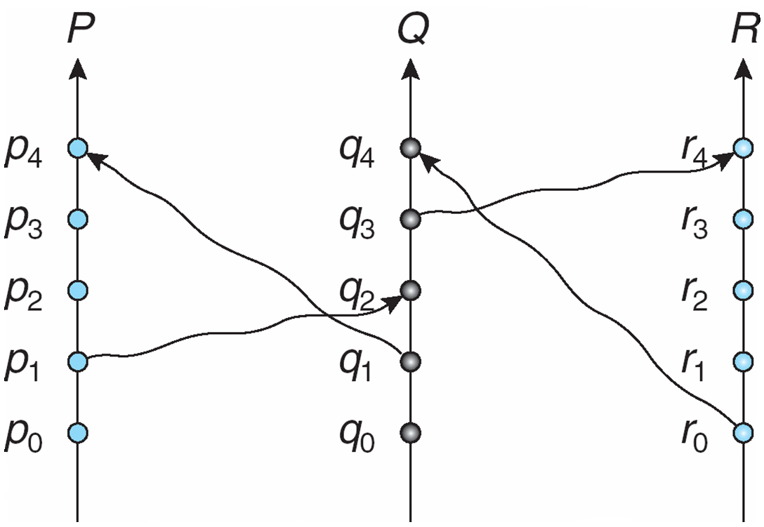
Relative Time for
Three Concurrent Processes

Slide 6
Implementation of →
Associate a timestamp with each system event
  Require that for every pair of events A and B, if A → B, then the timestamp of A is less than the timestamp of B
Within each process Pi a logical clock, LCi is associated
  The logical clock can be implemented as a simple counter that is incremented between any two successive events executed within a process
    Logical clock is monotonically increasing
A process advances its logical clock when it receives a message whose timestamp is greater than the current value of its logical clock
If the timestamps of two events A and B are the same, then the events are concurrent
  We may use the process identity numbers to break ties and to create a total ordering

Slide 7
Distributed Mutual Exclusion (DME)
Assumptions
  The system consists of n processes; each process P_{i} resides at a different processor
  Each process has a critical section that requires mutual exclusion
Requirement
  If P_{i} is executing in its critical section, then no other process P_{j} is executing in its critical section
We present two algorithms to ensure the mutual exclusion execution of processes in their critical sections

Slide 8
DME: Centralized Approach
One of the processes in the system is chosen to coordinate the entry to the critical section
A process that wants to enter its critical section sends a request message to the coordinator
The coordinator decides which process can enter the critical section next, and its sends that process a reply message
When the process receives a reply message from the coordinator, it enters its critical section
After exiting its critical section, the process sends a release message to the coordinator and proceeds with its execution
This scheme requires three messages per critical-section entry:
  request
  reply
  release

Slide 9
DME: Fully Distributed Approach
When process P_{i} wants to enter its critical section, it generates a new timestamp, TS, and sends the message request (P_{i}, TS) to all other processes in the system
When process P_{j} receives a request message, it may reply immediately or it may defer sending a reply back
When process P_{i} receives a reply message from all other processes in the system, it can enter its critical section
After exiting its critical section, the process sends reply messages to all its deferred requests

Slide 10
DME: Fully Distributed Approach (Cont.)
The decision whether process P_{j} replies immediately to a request(P_{i}, TS) message or defers its reply is based on three factors:
  If P_{j} is in its critical section, then it defers its reply to P_{i}
  If P_{j} does not want to enter its critical section, then it sends a reply immediately to P_{i}
  If P_{j} wants to enter its critical section but has not yet entered it, then it compares its own request timestamp with the timestamp TS
    If its own request timestamp is greater than TS, then it sends a reply immediately to P_{i} (P_{i} asked first)
    Otherwise, the reply is deferred

Slide 11
Desirable Behavior of
Fully Distributed Approach
Freedom from Deadlock is ensured
Freedom from starvation is ensured, since entry to the critical section is scheduled according to the timestamp ordering
  The timestamp ordering ensures that processes are served in a first-come, first served order
The number of messages per critical-section entry is
2 x (n – 1)
This is the minimum number of required messages per critical-section entry when processes act independently and concurrently

Slide 12
Three Undesirable Consequences
The processes need to know the identity of all other processes in the system, which makes the dynamic addition and removal of processes more complex
If one of the processes fails, then the entire scheme collapses
  This can be dealt with by continuously monitoring the state of all the processes in the system
Processes that have not entered their critical section must pause frequently to assure other processes that they intend to enter the critical section
  This protocol is therefore suited for small, stable sets of cooperating processes

Slide 13
Token-Passing Approach
Circulate a token among processes in system
  Token is special type of message
  Possession of token entitles holder to enter critical section
Processes logically organized in a ring structure
Unidirectional ring guarantees freedom from starvation
Two types of failures
  Lost token – election must be called
  Failed processes – new logical ring established

Slide 14
Atomicity
Either all the operations associated with a program unit are executed to completion, or none are performed
Ensuring atomicity in a distributed system requires a transaction coordinator, which is responsible for the following:
  Starting the execution of the transaction
  Breaking the transaction into a number of subtransactions, and distribution these subtransactions to the appropriate sites for execution
  Coordinating the termination of the transaction, which may result in the transaction being committed at all sites or aborted at all sites

Slide 15
Two-Phase Commit Protocol (2PC)
Assumes fail-stop model
Execution of the protocol is initiated by the coordinator after the last step of the transaction has been reached
When the protocol is initiated, the transaction may still be executing at some of the local sites
The protocol involves all the local sites at which the transaction executed
Example: Let T be a transaction initiated at site S_{i} and let the transaction coordinator at S_{i} be C_{i}

Slide 16
Phase 1: Obtaining a Decision
C_{i} adds <prepare T> record to the log
C_{i} sends <prepare T> message to all sites
When a site receives a <prepare T> message, the transaction manager determines if it can commit the transaction
  If no: add <no T> record to the log and respond to C_{i} with <abort T>
  If yes:
    add <ready T> record to the log
    force all log records for T onto stable storage
    send <ready T> message to C_{i}

Slide 17
Phase 1 (Cont.)
Coordinator collects responses
  All respond “ready”,
  decision is commit
  At least one response is “abort”,
  decision is abort
  At least one participant fails to respond within time out period,
  decision is abort

Slide 18
Phase 2: Recording Decision in the Database
Coordinator adds a decision record
<abort T> or <commit T>
to its log and forces record onto stable storage
Once that record reaches stable storage it is irrevocable (even if failures occur)
Coordinator sends a message to each participant informing it of the decision (commit or abort)
Participants take appropriate action locally

Slide 19
Failure Handling in 2PC – Site Failure
The log contains a <commit T> record
  In this case, the site executes redo(T)
The log contains an <abort T> record
  In this case, the site executes undo(T)
The contains a <ready T> record; consult C_{i}
  If C_{i} is down, site sends query-status T message to the other sites
The log contains no control records concerning T
  In this case, the site executes undo(T)

Slide 20
Failure Handling in 2PC –
Coordinator C_{i} Failure
If an active site contains a <commit T> record in its log, the T must be committed
If an active site contains an <abort T> record in its log, then T must be aborted
If some active site does not contain the record <ready T> in its log then the failed coordinator C_{i} cannot have decided to
commit T
  Rather than wait for C_{i} to recover, it is preferable to abort T
All active sites have a <ready T> record in their logs, but no additional control records
  In this case we must wait for the coordinator to recover
  Blocking problem – T is blocked pending the recovery of site S_{i}

Slide 21
Concurrency Control
Modify the centralized concurrency schemes to accommodate the distribution of transactions
Transaction manager coordinates execution of transactions (or subtransactions) that access data at local sites
Local transaction only executes at that site
Global transaction executes at several sites

Slide 22
Locking Protocols
Can use the two-phase locking protocol in a distributed environment by changing how the lock manager is implemented
Nonreplicated scheme – each site maintains a local lock manager which administers lock and unlock requests for those data items that are stored in that site
  Simple implementation involves two message transfers for handling lock requests, and one message transfer for handling unlock requests
  Deadlock handling is more complex

Slide 23
Single-Coordinator Approach
A single lock manager resides in a single chosen site, all lock and unlock requests are made a that site
Simple implementation
Simple deadlock handling
Possibility of bottleneck
Vulnerable to loss of concurrency controller if single site fails
Multiple-coordinator approach distributes lock-manager function over several sites

Slide 24
Majority Protocol
Avoids drawbacks of central control by dealing with replicated data in a decentralized manner
More complicated to implement
Deadlock-handling algorithms must be modified; possible for deadlock to occur in locking only one data item

Slide 25
Biased Protocol
Similar to majority protocol, but requests for shared locks prioritized over requests for exclusive locks
Less overhead on read operations than in majority protocol; but has additional overhead on writes
Like majority protocol, deadlock handling is complex

Slide 26
Primary Copy
One of the sites at which a replica resides is designated as the primary site
  Request to lock a data item is made at the primary site of that data item
Concurrency control for replicated data handled in a manner similar to that of unreplicated data
Simple implementation, but if primary site fails, the data item is unavailable, even though other sites may have a replica

Slide 27
Timestamping
Generate unique timestamps in distributed scheme:
  Each site generates a unique local timestamp
  The global unique timestamp is obtained by concatenation of the unique local timestamp with the unique site identifier
  Use a logical clock defined within each site to ensure the fair generation of timestamps
Timestamp-ordering scheme – combine the centralized concurrency control timestamp scheme with the 2PC protocol to obtain a protocol that ensures serializability with no cascading rollbacks

Slide 28
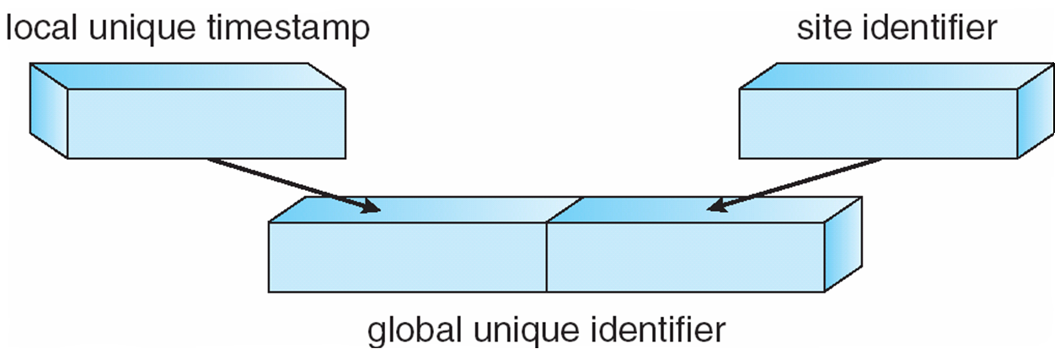
Generation of Unique Timestamps

Slide 29
Deadlock Prevention
Resource-ordering deadlock-prevention – define a global ordering among the system resources
  Assign a unique number to all system resources
  A process may request a resource with unique number i only if it is not holding a resource with a unique number grater than i
  Simple to implement; requires little overhead
Banker’s algorithm – designate one of the processes in the system as the process that maintains the information necessary to carry out the Banker’s algorithm
  Also implemented easily, but may require too much overhead

Slide 30
Timestamped Deadlock-
Prevention Scheme
Each process P_{i} is assigned a unique priority number
Priority numbers are used to decide whether a process P_{i} should wait for a process P_{j}; otherwise P_{i} is rolled back
The scheme prevents deadlocks
  For every edge P_{i} → P_{j} in the wait-for graph, P_{i} has a higher priority than P_{j}
  Thus a cycle cannot exist

Slide 31
Wait-Die Scheme
Based on a nonpreemptive technique
If P_{i} requests a resource currently held by P_{j}, P_{i} is allowed to wait only if it has a smaller timestamp than does P_{j} (P_{i} is older than P_{j})
  Otherwise, P_{i} is rolled back (dies)
Example: Suppose that processes P₁, P₂, and P₃ have timestamps 5, 10, and 15 respectively
  if P₁ request a resource held by P₂, then P₁ will wait
  If P₃ requests a resource held by P₂, then P₃ will be rolled back

Slide 32
Would-Wait Scheme
Based on a preemptive technique; counterpart to the wait-die system
If P_{i} requests a resource currently held by P_{j}, P_{i} is allowed to wait only if it has a larger timestamp than does P_{j} (P_{i} is younger than P_{j}). Otherwise P_{j} is rolled back (P_{j} is wounded by P_{i})
Example: Suppose that processes P₁, P_{2,} and P₃ have timestamps 5, 10, and 15 respectively
  If P₁ requests a resource held by P₂, then the resource will be preempted from P₂ and P₂ will be rolled back
  If P₃ requests a resource held by P₂, then P₃ will wait

Slide 33
Deadlock Detection
Use wait-for graphs
  Local wait-for graphs at each local site. The nodes of the graph correspond to all the processes that are currently either holding or requesting any of the resources local to that site
  May also use a global wait-for graph. This graph is the union of all local wait-for graphs.

Slide 34
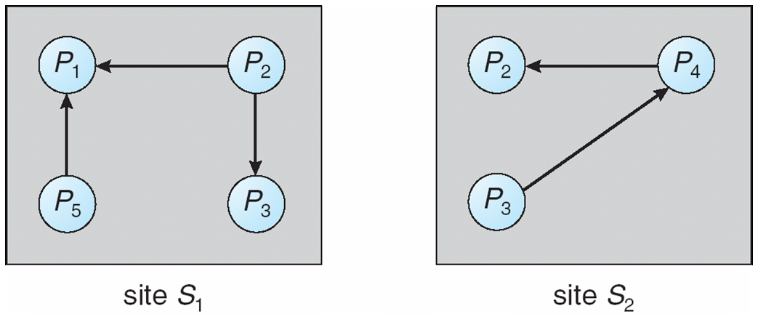
Two Local Wait-For Graphs

Slide 35
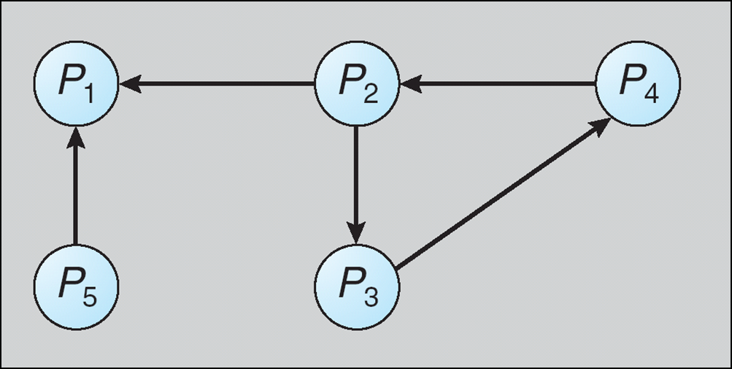
Global Wait-For Graph

Slide 36
Deadlock Detection –
Centralized Approach
Each site keeps a local wait-for graph
A global wait-for graph is maintained in a single coordination process
There are three different options (points in time) when the wait-for graph may be constructed:
  1. Whenever a new edge is inserted or removed in one of the local wait-for graphs
  2. Periodically, when a number of changes have occurred in a wait-for graph
  3. Whenever the coordinator needs to invoke the cycle-detection algorithm
Unnecessary rollbacks may occur as a result of false cycles

Slide 37
Detection Algorithm Based on Option 3
Append unique identifiers (timestamps) to requests form different sites
When process P_{i}, at site A, requests a resource from process P_{j}, at site B, a request message with timestamp TS is sent
The edge P_{i} → P_{j} with the label TS is inserted in the local wait-for of A. The edge is inserted in the local wait-for graph of B only if B has received the request message and cannot immediately grant the requested resource

Slide 38
The Algorithm
1. The controller sends an initiating message to each site in the system
2. On receiving this message, a site sends its local wait-for graph to the coordinator
3. When the controller has received a reply from each site, it constructs a graph as follows:
  (a) The constructed graph contains a vertex for every process in the system
  (b) The graph has an edge Pi → Pj if and only if
    there is an edge Pi → Pj in one of the wait-for graphs, or
    an edge Pi → Pj with some label TS appears in more than one wait-for graph
If the constructed graph contains a cycle ⇒ deadlock

Slide 39
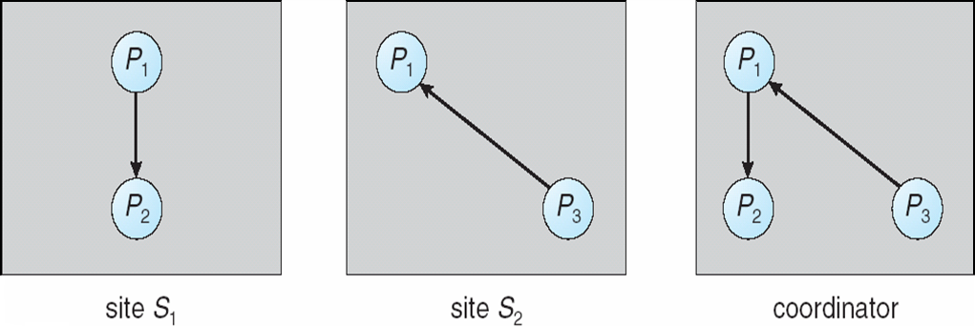
Local and Global Wait-For Graphs

Slide 40
Fully Distributed Approach
All controllers share equally the responsibility for detecting deadlock
Every site constructs a wait-for graph that represents a part of the total graph
We add one additional node P_{ex} to each local wait-for graph
If a local wait-for graph contains a cycle that does not involve node P_{ex}, then the system is in a deadlock state
A cycle involving P_{ex} implies the possibility of a deadlock
  To ascertain whether a deadlock does exist, a distributed deadlock-detection algorithm must be invoked

Slide 41
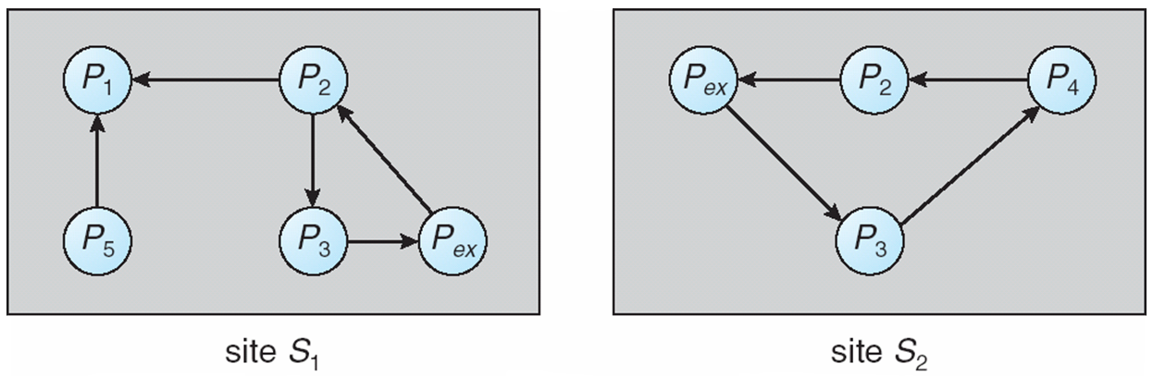
Augmented Local Wait-For Graphs

Slide 42
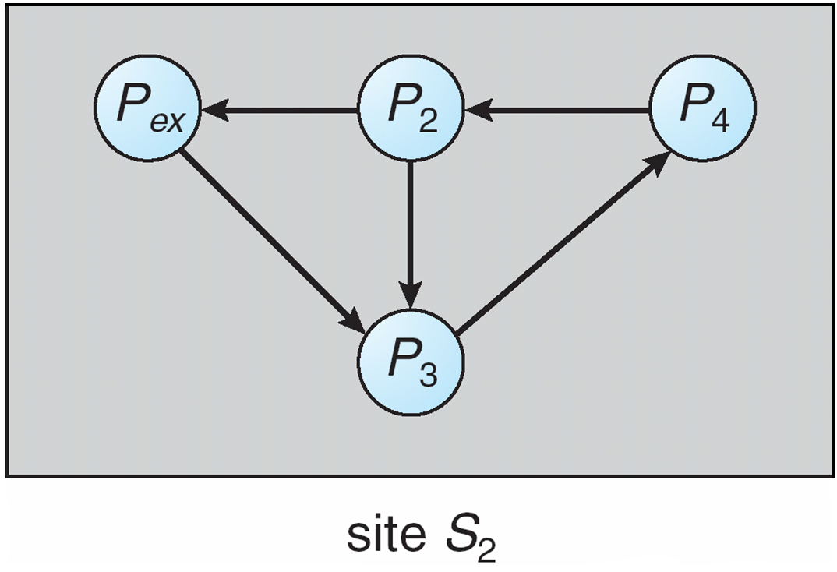
Augmented Local Wait-For Graph in Site S2

Slide 43
Election Algorithms
Determine where a new copy of the coordinator should be restarted
Assume that a unique priority number is associated with each active process in the system, and assume that the priority number of process P_{i} is I
Assume a one-to-one correspondence between processes and sites
The coordinator is always the process with the largest priority number. When a coordinator fails, the algorithm must elect that active process with the largest priority number
Two algorithms, the bully algorithm and a ring algorithm, can be used to elect a new coordinator in case of failures

Slide 44
Bully Algorithm
Applicable to systems where every process can send a message to every other process in the system
If process P_{i} sends a request that is not answered by the coordinator within a time interval T, assume that the coordinator has failed; P_{i} tries to elect itself as the new coordinator
P_{i} sends an election message to every process with a higher priority number, P_{i} then waits for any of these processes to answer within T

Slide 45
Bully Algorithm (Cont.)
If no response within T, assume that all processes with numbers greater than i have failed; P_{i} elects itself the new coordinator
If answer is received, P_{i} begins time interval T´, waiting to receive a message that a process with a higher priority number has been elected
If no message is sent within T´, assume the process with a higher number has failed; P_{i} should restart the algorithm

Slide 46
Bully Algorithm (Cont.)
If P_{i} is not the coordinator, then, at any time during execution, P_{i} may receive one of the following two messages from process P_{j}
  P_{j} is the new coordinator (j > i). P_{i}, in turn, records this information
  P_{j} started an election (j > i). P_{i}, sends a response to P_{j} and begins its own election algorithm, provided that Pi has not already initiated such an election
After a failed process recovers, it immediately begins execution of the same algorithm
If there are no active processes with higher numbers, the recovered process forces all processes with lower number to let it become the coordinator process, even if there is a currently active coordinator with a lower number

Slide 47
Ring Algorithm
Applicable to systems organized as a ring (logically or physically)
Assumes that the links are unidirectional, and that processes send their messages to their right neighbors
Each process maintains an active list, consisting of all the priority numbers of all active processes in the system when the algorithm ends
If process Pi detects a coordinator failure, I creates a new active list that is initially empty. It then sends a message elect(i) to its right neighbor, and adds the number i to its active list

Slide 48
Ring Algorithm (Cont.)
If P_{i} receives a message elect(j) from the process on the left, it must respond in one of three ways:
  If this is the first elect message it has seen or sent, P_{i} creates a new active list with the numbers i and j
    It then sends the message elect(i), followed by the message elect(j)
  If i ≠ j, then the active list for P_{i} now contains the numbers of all the active processes in the system
    P_{i} can now determine the largest number in the active list to identify the new coordinator process
  If i = j, then P_{i} receives the message elect(i)
    The active list for P_{i} contains all the active processes in the system
      P_{i} can now determine the new coordinator process.

Slide 49
Reaching Agreement
There are applications where a set of processes wish to agree on a common “value”
Such agreement may not take place due to:
  Faulty communication medium
  Faulty processes
    Processes may send garbled or incorrect messages to other processes
    A subset of the processes may collaborate with each other in an attempt to defeat the scheme

Slide 50
Faulty Communications
Process P_{i} at site A, has sent a message to process P_{j} at site B; to proceed, P_{i} needs to know if P_{j} has received the message
Detect failures using a time-out scheme
  When P_{i} sends out a message, it also specifies a time interval during which it is willing to wait for an acknowledgment message form P_{j}
  When P_{j} receives the message, it immediately sends an acknowledgment to P_{i}
  If P_{i} receives the acknowledgment message within the specified time interval, it concludes that P_{j} has received its message
    If a time-out occurs, P_{j} needs to retransmit its message and wait for an acknowledgment
  Continue until P_{i} either receives an acknowledgment, or is notified by the system that B is down

Slide 51
Faulty Communications (Cont.)
Suppose that P_{j} also needs to know that P_{i} has received its acknowledgment message, in order to decide on how to proceed
  In the presence of failure, it is not possible to accomplish this task
  It is not possible in a distributed environment for processes P_{i} and P_{j} to agree completely on their respective states

Slide 52
Faulty Processes
(Byzantine Generals Problem)
Communication medium is reliable, but processes can fail in unpredictable ways
Consider a system of n processes, of which no more than m are faulty
  Suppose that each process P_{i} has some private value of V_{i}
Devise an algorithm that allows each nonfaulty P_{i} to construct a vector X_{i} = (A_{i,1}, A_{i,2}, …, A_{i,n}) such that::
  If P_{j} is a nonfaulty process, then A_{ij} = V_{j.}
  If P_{i} and P_{j} are both nonfaulty processes, then X_{i} = X_{j}.
Solutions share the following properties
  A correct algorithm can be devised only if n ≥ 3 x m + 1
  The worst-case delay for reaching agreement is proportionate to m + 1 message-passing delays

Slide 53
Faulty Processes (Cont.)
An algorithm for the case where m = 1 and n = 4 requires two rounds of information exchange:
  Each process sends its private value to the other 3 processes
  Each process sends the information it has obtained in the first round to all other processes
If a faulty process refuses to send messages, a nonfaulty process can choose an arbitrary value and pretend that that value was sent by that process
After the two rounds are completed, a nonfaulty process Pi can construct its vector Xi = (Ai,1, Ai,2, Ai,3, Ai,4) as follows:
  A_{i,j} = V_{i}
  For j ≠ i, if at least two of the three values reported for process P_{j} agree, then the majority value is used to set the value of A_{ij}
    Otherwise, a default value (nil) is used

Slide 54
End of Chapter 18

