Slide 1
Chapter 22: Windows XP

Slide 2
Chapter 22: Windows XP
History
Design Principles
System Components
Environmental Subsystems
File system
Networking
Programmer Interface

Slide 3
Objectives
To explore the principles upon which Windows XP is designed and the specific components involved in the system
To understand how Windows XP can run programs designed for other operating systems
To provide a detailed explanation of the Windows XP file system
To illustrate the networking protocols supported in Windows XP
To cover the interface available to system and application programmers

Slide 4
Windows XP
32-bit preemptive multitasking operating system for Intel microprocessors
Key goals for the system:
  portability
  security
  POSIX compliance
  multiprocessor support
  extensibility
  international support
  compatibility with MS-DOS and MS-Windows applications.
Uses a micro-kernel architecture
Available in four versions, Professional, Server, Advanced Server, National Server

Slide 5
History
In 1988, Microsoft decided to develop a “new technology” (NT) portable operating system that supported both the OS/2 and POSIX APIs.
Originally, NT was supposed to use the OS/2 API as its native environment but during development NT was changed to use the Win32 API, reflecting the popularity of Windows 3.0.

Slide 6
Design Principles
Extensibility — layered architecture
  Executive, which runs in protected mode, provides the basic system services
  On top of the executive, several server subsystems operate in user mode
  Modular structure allows additional environmental subsystems to be added without affecting the executive
Portability —XP can be moved from on hardware architecture to another with relatively few changes
  Written in C and C++
  Processor-dependent code is isolated in a dynamic link library (DLL) called the “hardware abstraction layer” (HAL)

Slide 7
Design Principles (Cont.)
Reliability —XP uses hardware protection for virtual memory, and software protection mechanisms for operating system resources
Compatibility — applications that follow the IEEE 1003.1 (POSIX) standard can be complied to run on XP without changing the source code
Performance —XP subsystems can communicate with one another via high-performance message passing
  Preemption of low priority threads enables the system to respond quickly to external events
  Designed for symmetrical multiprocessing
International support — supports different locales via the national language support (NLS) API

Slide 8
XP Architecture
Layered system of modules
Protected mode — hardware abstraction layer (HAL), kernel, executive
User mode — collection of subsystems
  Environmental subsystems emulate different operating systems
  Protection subsystems provide security functions

Slide 9
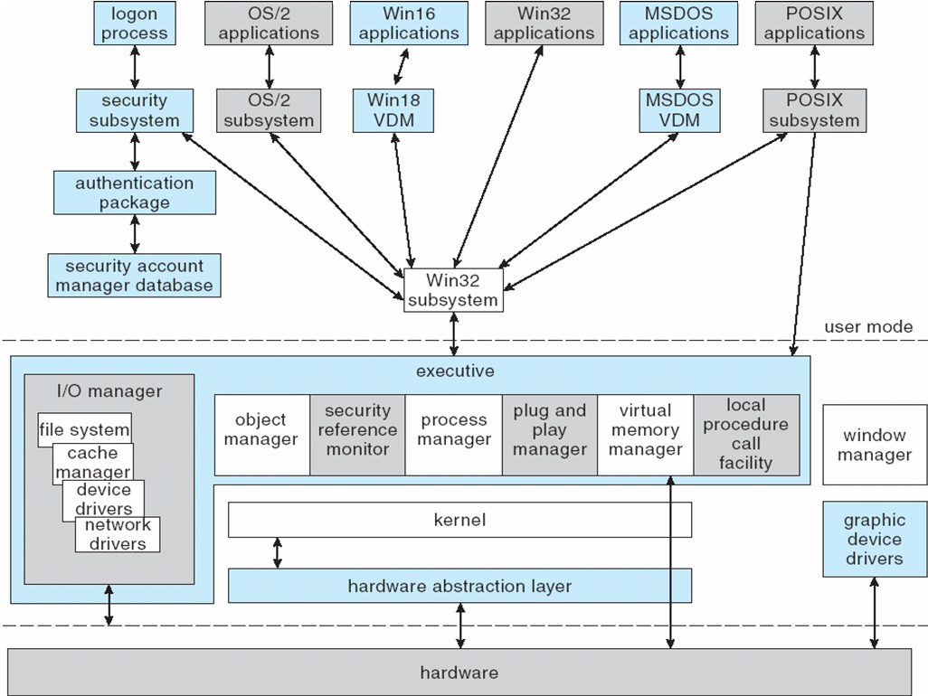
Depiction of XP Architecture

Slide 10
System Components — Kernel
Foundation for the executive and the subsystems
Never paged out of memory; execution is never preempted
Four main responsibilities:
  thread scheduling
  interrupt and exception handling
  low-level processor synchronization
  recovery after a power failure
Kernel is object-oriented, uses two sets of objects
  dispatcher objects control dispatching and synchronization (events, mutants, mutexes, semaphores, threads and timers)
  control objects (asynchronous procedure calls, interrupts, power notify, power status, process and profile objects)

Slide 11
Kernel — Process and Threads
The process has a virtual memory address space, information (such as a base priority), and an affinity for one or more processors.
Threads are the unit of execution scheduled by the kernel’s dispatcher.
Each thread has its own state, including a priority, processor affinity, and accounting information.
A thread can be one of six states: ready, standby, running, waiting, transition, and terminated.

Slide 12
Kernel — Scheduling
The dispatcher uses a 32-level priority scheme to determine the order of thread execution.
  Priorities are divided into two classes
    The real-time class contains threads with priorities ranging from 16 to 31
    The variable class contains threads having priorities from 0 to 15
Characteristics of XP’s priority strategy
  Trends to give very good response times to interactive threads that are using the mouse and windows
  Enables I/O-bound threads to keep the I/O devices busy
  Complete-bound threads soak up the spare CPU cycles in the background

Slide 13
Kernel — Scheduling (Cont.)
Scheduling can occur when a thread enters the ready or wait state, when a thread terminates, or when an application changes a thread’s priority or processor affinity.
Real-time threads are given preferential access to the CPU; but XP does not guarantee that a real-time thread will start to execute within any particular time limit .
  This is known as soft realtime.

Slide 14
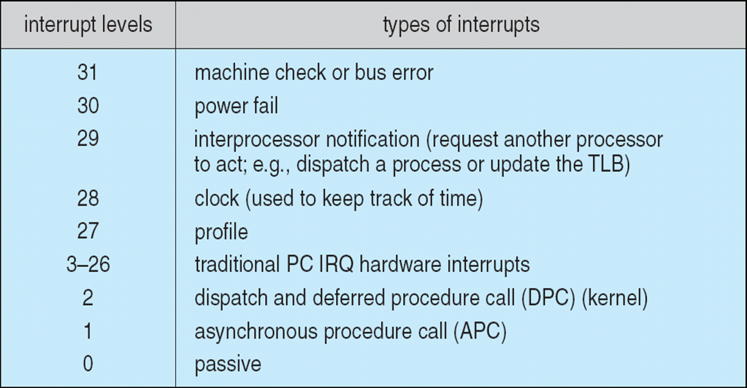
Windows XP Interrupt Request Levels

Slide 15
Kernel — Trap Handling
The kernel provides trap handling when exceptions and interrupts are generated by hardware of software.
Exceptions that cannot be handled by the trap handler are handled by the kernel's exception dispatcher.
The interrupt dispatcher in the kernel handles interrupts by calling either an interrupt service routine (such as in a device driver) or an internal kernel routine.
The kernel uses spin locks that reside in global memory to achieve multiprocessor mutual exclusion.

Slide 16
Executive — Object Manager
XP uses objects for all its services and entities; the object manger supervises the use of all the objects
  Generates an object handle
  Checks security
  Keeps track of which processes are using each object
Objects are manipulated by a standard set of methods, namely create, open, close, delete, query name, parse and security.

Slide 17
Executive — Naming Objects
The XP executive allows any object to be given a name, which may be either permanent or temporary.
Object names are structured like file path names in MS-DOS and UNIX.
XP implements a symbolic link object, which is similar to symbolic links in UNIX that allow multiple nicknames or aliases to refer to the same file.
A process gets an object handle by creating an object by opening an existing one, by receiving a duplicated handle from another process, or by inheriting a handle from a parent process.
Each object is protected by an access control list.

Slide 18
Executive — Virtual Memory Manager
The design of the VM manager assumes that the underlying hardware supports virtual to physical mapping a paging mechanism, transparent cache coherence on multiprocessor systems, and virtual addressing aliasing.
The VM manager in XP uses a page-based management scheme with a page size of 4 KB.
The XP VM manager uses a two step process to allocate memory
  The first step reserves a portion of the process’s address space
  The second step commits the allocation by assigning space in the 2000 paging file

Slide 19
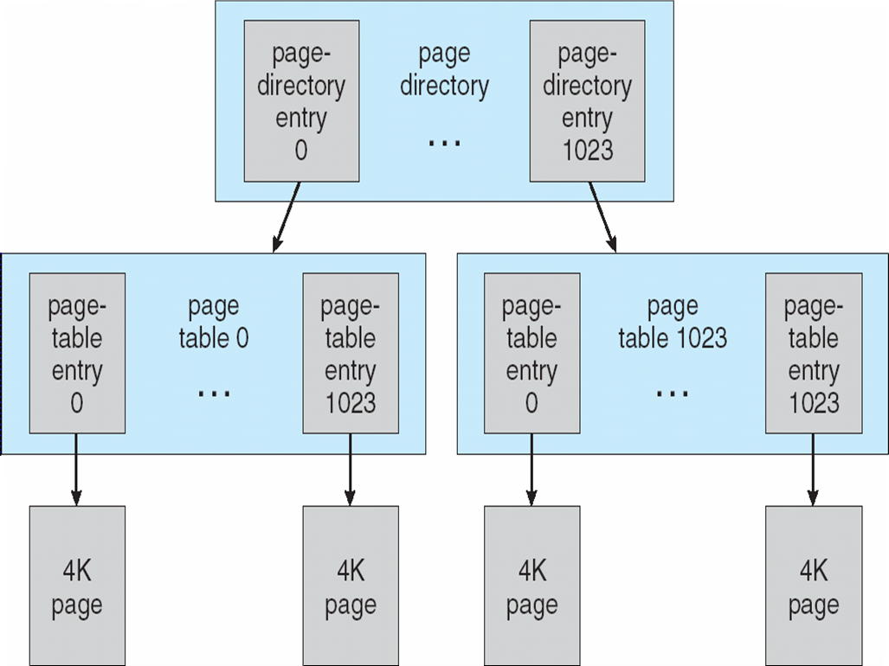
Virtual-Memory Layout

Slide 20
Virtual Memory Manager (Cont.)
The virtual address translation in XP uses several data structures
  Each process has a page directory that contains 1024 page directory entries of size 4 bytes.
  Each page directory entry points to a page table which contains 1024 page table entries (PTEs) of size 4 bytes.
  Each PTE points to a 4 KB page frame in physical memory.
A 10-bit integer can represent all the values form 0 to 1023, therefore, can select any entry in the page directory, or in a page table.
This property is used when translating a virtual address pointer to a bye address in physical memory.
A page can be in one of six states: valid, zeroed, free standby, modified and bad.

Slide 21
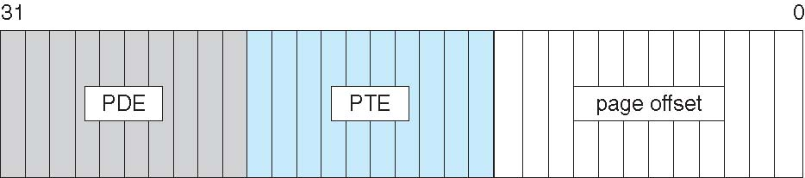
Virtual-to-Physical Address Translation
10 bits for page directory entry, 20 bits for page table entry, and 12 bits for byte offset in page

Slide 22
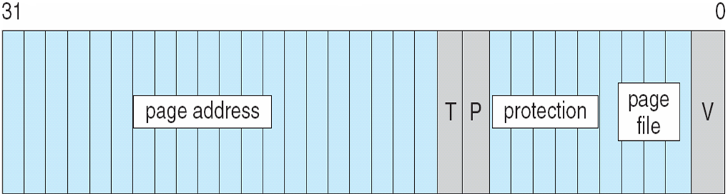
Page File Page-Table Entry
5 bits for page protection, 20 bits for page frame address, 4 bits to select a paging file, and 3 bits that describe the page state. V = 0

Slide 23
Executive — Process Manager
Provides services for creating, deleting, and using threads and processes
Issues such as parent/child relationships or process hierarchies are left to the particular environmental subsystem that owns the process.

Slide 24
Executive — Local Procedure Call Facility
The LPC passes requests and results between client and server processes within a single machine.
In particular, it is used to request services from the various XP subsystems.
When a LPC channel is created, one of three types of message passing techniques must be specified.
  First type is suitable for small messages, up to 256 bytes; port's message queue is used as intermediate storage, and the messages are copied from one process to the other.
  Second type avoids copying large messages by pointing to a shared memory section object created for the channel.
  Third method, called quick LPC was used by graphical display portions of the Win32 subsystem.

Slide 25
Executive — I/O Manager
The I/O manager is responsible for
  file systems
  cache management
  device drivers
  network drivers
Keeps track of which installable file systems are loaded, and manages buffers for I/O requests
Works with VM Manager to provide memory-mapped file I/O
Controls the XP cache manager, which handles caching for the entire I/O system
Supports both synchronous and asynchronous operations, provides time outs for drivers, and has mechanisms for one driver to call another

Slide 26
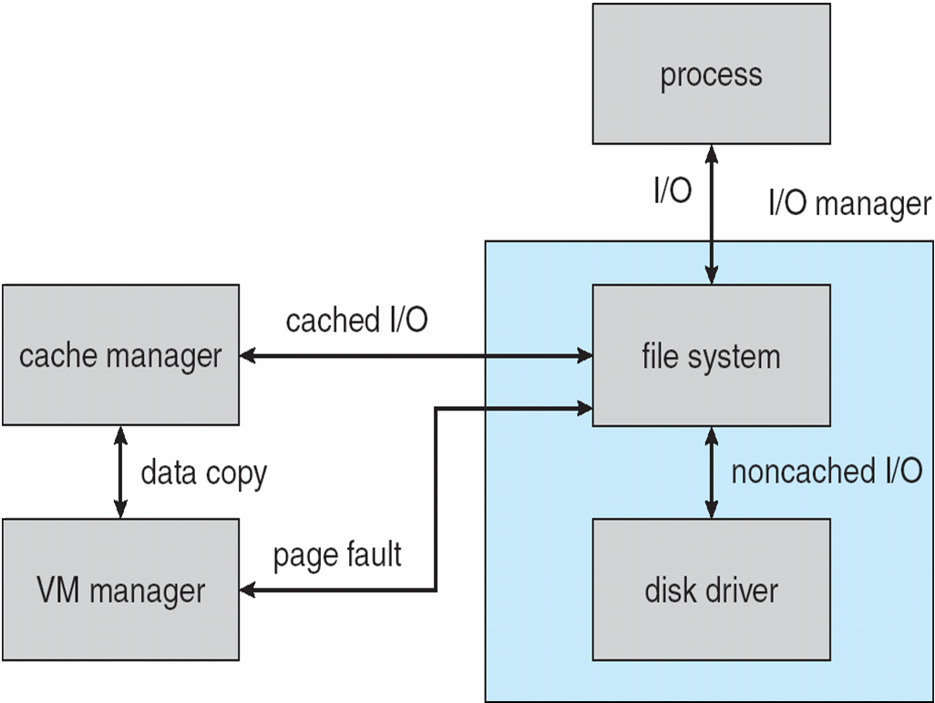
File I/O

Slide 27
Executive — Security Reference Monitor
The object-oriented nature of XP enables the use of a uniform mechanism to perform runtime access validation and audit checks for every entity in the system.
Whenever a process opens a handle to an object, the security reference monitor checks the process’s security token and the object’s access control list to see whether the process has the necessary rights.

Slide 28
Executive – Plug-and-Play Manager
Plug-and-Play (PnP) manager is used to recognize and adapt to changes in the hardware configuration.
When new devices are added (for example, PCI or USB), the PnP manager loads the appropriate driver.
The manager also keeps track of the resources used by each device.

Slide 29
Environmental Subsystems
User-mode processes layered over the native XP executive services to enable XP to run programs developed for other operating system.
XP uses the Win32 subsystem as the main operating environment; Win32 is used to start all processes.
  It also provides all the keyboard, mouse and graphical display capabilities.
MS-DOS environment is provided by a Win32 application called the virtual dos machine (VDM), a user-mode process that is paged and dispatched like any other XP thread.

Slide 30
Environmental Subsystems (Cont.)
16-Bit Windows Environment:
  Provided by a VDM that incorporates Windows on Windows
  Provides the Windows 3.1 kernel routines and sub routines for window manager and GDI functions
The POSIX subsystem is designed to run POSIX applications following the POSIX.1 standard which is based on the UNIX model.

Slide 31
Environmental Subsystems (Cont.)
OS/2 subsystems runs OS/2 applications
Logon and Security Subsystems authenticates users logging on to Windows XP systems
  Users are required to have account names and passwords.
  The authentication package authenticates users whenever they attempt to access an object in the system.
  Windows XP uses Kerberos as the default authentication package

Slide 32
File System
The fundamental structure of the XP file system (NTFS) is a volume
  Created by the XP disk administrator utility
  Based on a logical disk partition
  May occupy a portions of a disk, an entire disk, or span across several disks
All metadata, such as information about the volume, is stored in a regular file
NTFS uses clusters as the underlying unit of disk allocation
  A cluster is a number of disk sectors that is a power of two
  Because the cluster size is smaller than for the 16-bit FAT file system, the amount of internal fragmentation is reduced

Slide 33
File System — Internal Layout
NTFS uses logical cluster numbers (LCNs) as disk addresses
A file in NTFS is not a simple byte stream, as in MS-DOS or UNIX, rather, it is a structured object consisting of attributes
Every file in NTFS is described by one or more records in an array stored in a special file called the Master File Table (MFT)
Each file on an NTFS volume has a unique ID called a file reference.
  64-bit quantity that consists of a 48-bit file number and a 16-bit sequence number
  Can be used to perform internal consistency checks
The NTFS name space is organized by a hierarchy of directories; the index root contains the top level of the B+ tree

Slide 34
File System — Recovery
All file system data structure updates are performed inside transactions that are logged.
  Before a data structure is altered, the transaction writes a log record that contains redo and undo information.
  After the data structure has been changed, a commit record is written to the log to signify that the transaction succeeded.
  After a crash, the file system data structures can be restored to a consistent state by processing the log records.

Slide 35
File System — Recovery (Cont.)
This scheme does not guarantee that all the user file data can be recovered after a crash, just that the file system data structures (the metadata files) are undamaged and reflect some consistent state prior to the crash.
The log is stored in the third metadata file at the beginning of the volume.
The logging functionality is provided by the XP log file service.

Slide 36
File System — Security
Security of an NTFS volume is derived from the XP object model.
Each file object has a security descriptor attribute stored in this MFT record.
This attribute contains the access token of the owner of the file, and an access control list that states the access privileges that are granted to each user that has access to the file.

Slide 37
Volume Management and Fault Tolerance
FtDisk, the fault tolerant disk driver for XP, provides several ways to combine multiple SCSI disk drives into one logical volume
Logically concatenate multiple disks to form a large logical volume, a volume set
Interleave multiple physical partitions in round-robin fashion to form a stripe set (also called RAID level 0, or “disk striping”)
  Variation: stripe set with parity, or RAID level 5
Disk mirroring, or RAID level 1, is a robust scheme that uses a mirror set — two equally sized partitions on tow disks with identical data contents
To deal with disk sectors that go bad, FtDisk, uses a hardware technique called sector sparing and NTFS uses a software technique called cluster remapping

Slide 38
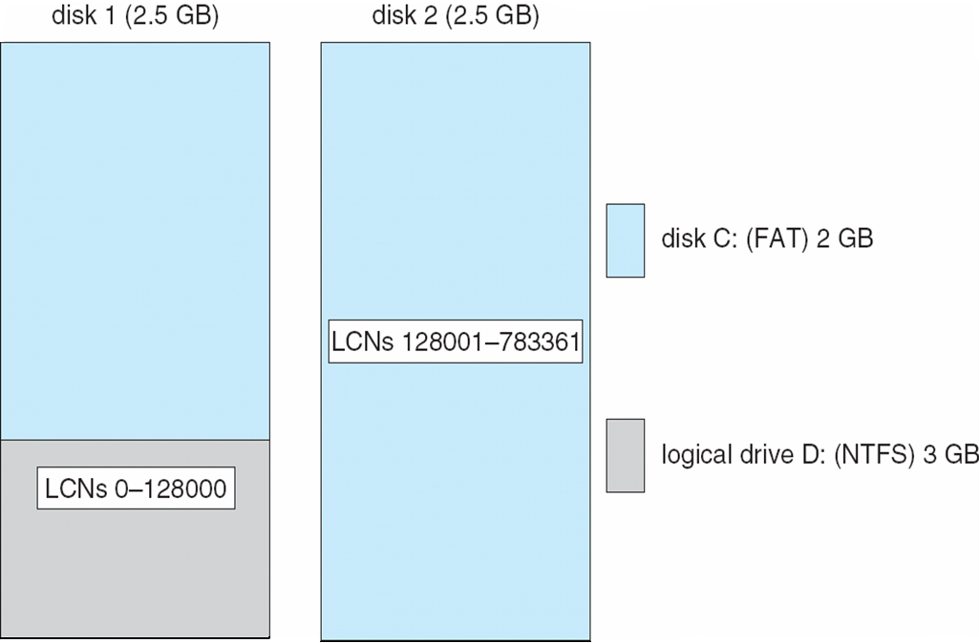
Volume Set On Two Drives

Slide 39
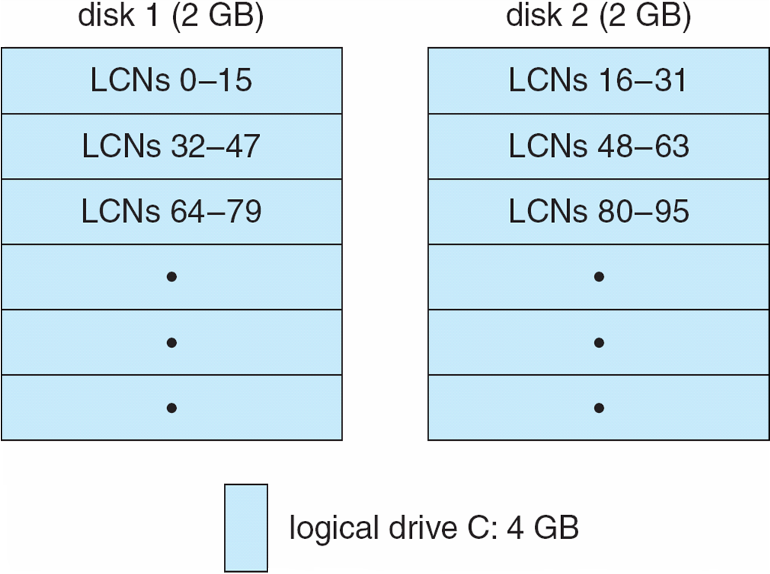
Stripe Set on Two Drives

Slide 40
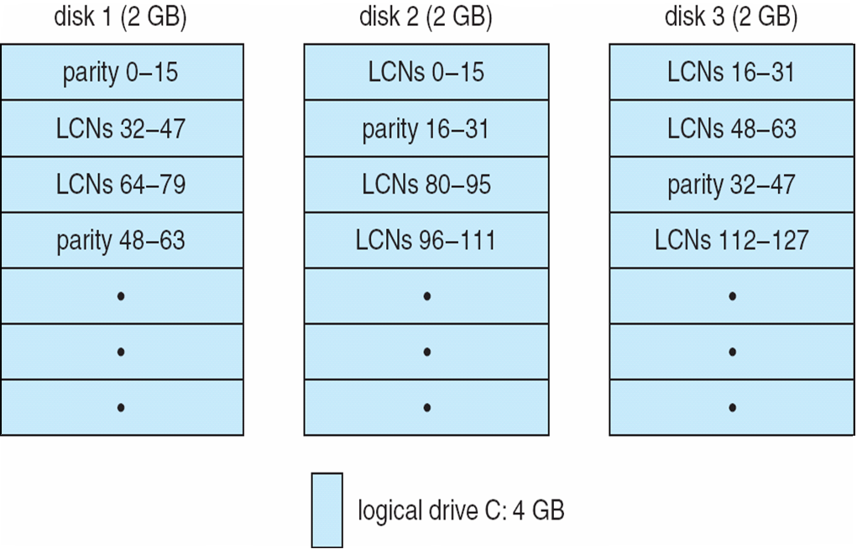
Stripe Set With Parity on Three Drives

Slide 41
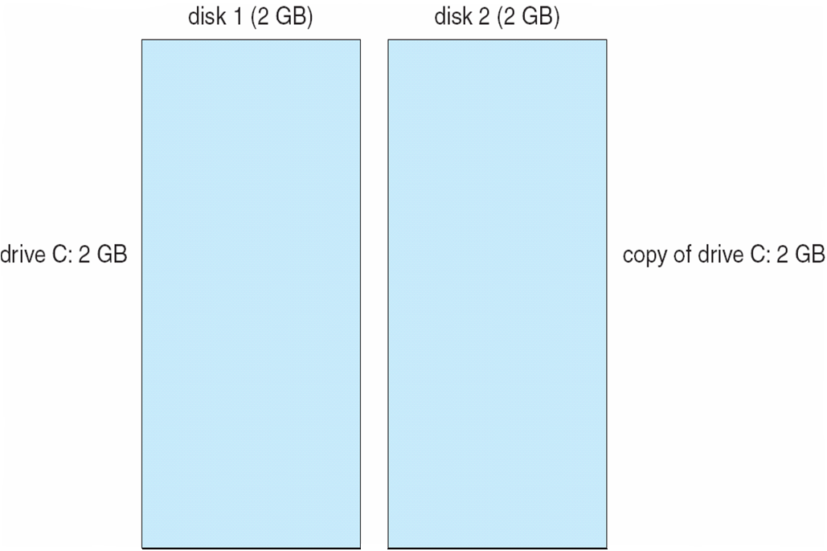
Mirror Set on Two Drives

Slide 42
File System — Compression
To compress a file, NTFS divides the file’s data into compression units, which are blocks of 16 contiguous clusters.
For sparse files, NTFS uses another technique to save space.
  Clusters that contain all zeros are not actually allocated or stored on disk.
  Instead, gaps are left in the sequence of virtual cluster numbers stored in the MFT entry for the file.
  When reading a file, if a gap in the virtual cluster numbers is found, NTFS just zero-fills that portion of the caller’s buffer.

Slide 43
File System — Reparse Points
A reparse point returns an error code when accessed. The reparse data tells the I/O manager what to do next.
Reparse points can be used to provide the functionality of UNIX mounts.
Reparse points can also be used to access files that have been moved to offline storage.

Slide 44
Networking
XP supports both peer-to-peer and client/server networking; it also has facilities for network management.
To describe networking in XP, we refer to two of the internal networking interfaces:
  NDIS (Network Device Interface Specification) — Separates network adapters from the transport protocols so that either can be changed without affecting the other.
  TDI (Transport Driver Interface) — Enables any session layer component to use any available transport mechanism.
XP implements transport protocols as drivers that can be loaded and unloaded from the system dynamically.

Slide 45
Networking — Protocols
The server message block (SMB) protocol is used to send I/O requests over the network. It has four message types:
  Session control
  File
  Printer
  Message
The network basic Input/Output system (NetBIOS) is a hardware abstraction interface for networks
  Used to:
    Establish logical names on the network
    Establish logical connections of sessions between two logical names on the network
    Support reliable data transfer for a session via NetBIOS requests or SMBs

Slide 46
Networking — Protocols (Cont.)
NetBEUI (NetBIOS Extended User Interface): default protocol for Windows 95 peer networking and Windows for Workgroups; used when XP wants to share resources with these networks.
XP uses the TCP/IP Internet protocol to connect to a wide variety of operating systems and hardware platforms.
PPTP (Point-to-Point Tunneling Protocol) is used to communicate between Remote Access Server modules running on XP machines that are connected over the Internet.
The XP NWLink protocol connects the NetBIOS to Novell NetWare networks.

Slide 47
Networking — Protocols (Cont.)
The Data Link Control protocol (DLC) is used to access IBM mainframes and HP printers that are directly connected to the network.
XP systems can communicate with Macintosh computers via the Apple Talk protocol if an XP Server on the network is running the Windows XP Services for Macintosh package.

Slide 48
Networking —
Dist. Processing Mechanisms
XP supports distributed applications via named NetBIOS, named pipes and mailslots, Windows Sockets, Remote Procedure Calls (RPC), and Network Dynamic Data Exchange (NetDDE).
NetBIOS applications can communicate over the network using NetBEUI, NWLink, or TCP/IP.
Named pipes are connection-oriented messaging mechanism that are named via the uniform naming convention (UNC).
Mailslots are a connectionless messaging mechanism that are used for broadcast applications, such as for finding components on the network.
Winsock, the windows sockets API, is a session-layer interface that provides a standardized interface to many transport protocols that may have different addressing schemes.

Slide 49
Distributed Processing Mechanisms (Cont.)
The XP RPC mechanism follows the widely-used Distributed Computing Environment standard for RPC messages, so programs written to use XP RPCs are very portable.
  RPC messages are sent using NetBIOS, or Winsock on TCP/IP networks, or named pipes on LAN Manager networks.
  XP provides the Microsoft Interface Definition Language to describe the remote procedure names, arguments, and results.

Slide 50
Networking —
Redirectors and Servers
In XP, an application can use the XP I/O API to access files from a remote computer as if they were local, provided that the remote computer is running an MS-NET server.
A redirector is the client-side object that forwards I/O requests to remote files, where they are satisfied by a server.
For performance and security, the redirectors and servers run in kernel mode.

Slide 51
Access to a Remote File
The application calls the I/O manager to request that a file be opened (we assume that the file name is in the standard UNC format).
The I/O manager builds an I/O request packet.
The I/O manager recognizes that the access is for a remote file, and calls a driver called a Multiple Universal Naming Convention Provider (MUP).
The MUP sends the I/O request packet asynchronously to all registered redirectors.
A redirector that can satisfy the request responds to the MUP
  To avoid asking all the redirectors the same question in the future, the MUP uses a cache to remember with redirector can handle this file.

Slide 52
Access to a Remote File (Cont.)
The redirector sends the network request to the remote system.
The remote system network drivers receive the request and pass it to the server driver.
The server driver hands the request to the proper local file system driver.
The proper device driver is called to access the data.
The results are returned to the server driver, which sends the data back to the requesting redirector.

Slide 53
Networking — Domains
NT uses the concept of a domain to manage global access rights within groups.
A domain is a group of machines running NT server that share a common security policy and user database.
XP provides three models of setting up trust relationships
  One way, A trusts B
  Two way, transitive, A trusts B, B trusts C so A, B, C trust each other
  Crosslink – allows authentication to bypass hierarchy to cut down on authentication traffic.

Slide 54
Name Resolution in TCP/IP Networks
On an IP network, name resolution is the process of converting a computer name to an IP address
e.g., www.bell-labs.com resolves to 135.104.1.14
XP provides several methods of name resolution:
  Windows Internet Name Service (WINS)
  broadcast name resolution
  domain name system (DNS)
  a host file
  an LMHOSTS file

Slide 55
Name Resolution (Cont.)
WINS consists of two or more WINS servers that maintain a dynamic database of name to IP address bindings, and client software to query the servers.
WINS uses the Dynamic Host Configuration Protocol (DHCP), which automatically updates address configurations in the WINS database, without user or administrator intervention.

Slide 56
Programmer Interface —
Access to Kernel Obj.
A process gains access to a kernel object named XXX by calling the CreateXXX function to open a handle to XXX; the handle is unique to that process.
A handle can be closed by calling the CloseHandle function; the system may delete the object if the count of processes using the object drops to 0.
XP provides three ways to share objects between processes
  A child process inherits a handle to the object
  One process gives the object a name when it is created and the second process opens that name
  DuplicateHandle function:
    Given a handle to process and the handle’s value a second process can get a handle to the same object, and thus share it

Slide 57
Programmer Interface —
Process Management
Process is started via the CreateProcess routine which loads any dynamic link libraries that are used by the process, and creates a primary thread.
Additional threads can be created by the CreateThread function.
Every dynamic link library or executable file that is loaded into the address space of a process is identified by an instance handle.

Slide 58
Process Management (Cont.)
Scheduling in Win32 utilizes four priority classes:
  IDLE_PRIORITY_CLASS (priority level 4)
  NORMAL_PRIORITY_CLASS (level8 — typical for most processes
  HIGH_PRIORITY_CLASS (level 13)
  REALTIME_PRIORITY_CLASS (level 24)
To provide performance levels needed for interactive programs, XP has a special scheduling rule for processes in the NORMAL_PRIORITY_CLASS
  XP distinguishes between the foreground process that is currently selected on the screen, and the background processes that are not currently selected.
  When a process moves into the foreground, XP increases the scheduling quantum by some factor, typically 3.

Slide 59
Process Management (Cont.)
The kernel dynamically adjusts the priority of a thread depending on whether it is I/O-bound or CPU-bound.
To synchronize the concurrent access to shared objects by threads, the kernel provides synchronization objects, such as semaphores and mutexes
  In addition, threads can synchronize by using the WaitForSingleObject or WaitForMultipleObjects functions.
  Another method of synchronization in the Win32 API is the critical section.

Slide 60
Process Management (Cont.)
A fiber is user-mode code that gets scheduled according to a user-defined scheduling algorithm.
  Only one fiber at a time is permitted to execute, even on multiprocessor hardware.
  XP includes fibers to facilitate the porting of legacy UNIX applications that are written for a fiber execution model.

Slide 61
Programmer Interface —
Interprocess Communication
Win32 applications can have interprocess communication by sharing kernel objects.
An alternate means of interprocess communications is message passing, which is particularly popular for Windows GUI applications
  One thread sends a message to another thread or to a window.
  A thread can also send data with the message.
Every Win32 thread has its own input queue from which the thread receives messages.
This is more reliable than the shared input queue of 16-bit windows, because with separate queues, one stuck application cannot block input to the other applications

Slide 62
Programmer Interface —
Memory Management
Virtual memory:
  VirtualAlloc reserves or commits virtual memory
  VirtualFree decommits or releases the memory
  These functions enable the application to determine the virtual address at which the memory is allocated
An application can use memory by memory mapping a file into its address space
  Multistage process
  Two processes share memory by mapping the same file into their virtual memory

Slide 63
Memory Management (Cont.)
A heap in the Win32 environment is a region of reserved address space
  A Win 32 process is created with a 1 MB default heap
  Access is synchronized to protect the heap’s space allocation data structures from damage by concurrent updates by multiple threads
Because functions that rely on global or static data typically fail to work properly in a multithreaded environment, the thread-local storage mechanism allocates global storage on a per-thread basis
  The mechanism provides both dynamic and static methods of creating thread-local storage

Slide 64
End of Chapter 22

